Slide 1
Analysis of Missing Migrants across different Geographic Regions
Omkar Ashok Kalange
Ayush Awadhesh Pandey

Slide 2
Objectives
This project is to shed some light into deaths of hundreds of migrants that are fleeing from countries engulfed in warfare and conflicts, or simply trying to find a better place to live in.
Hopefully, we will get a better understanding of the circumstances of their deaths and get to know overall patterns from that tragedies.
We hope that monitoring these tragic events and studying the data relating to them can help to avoid a recurrence of these. We are all human beings.

Slide 3
Data Description
The dataset comes from the Missing Migrant Project tht tracks the deaths of migrants that have perished on their way to their destination taken from United Nations International Organization for Migration (IOM) website

Slide 4

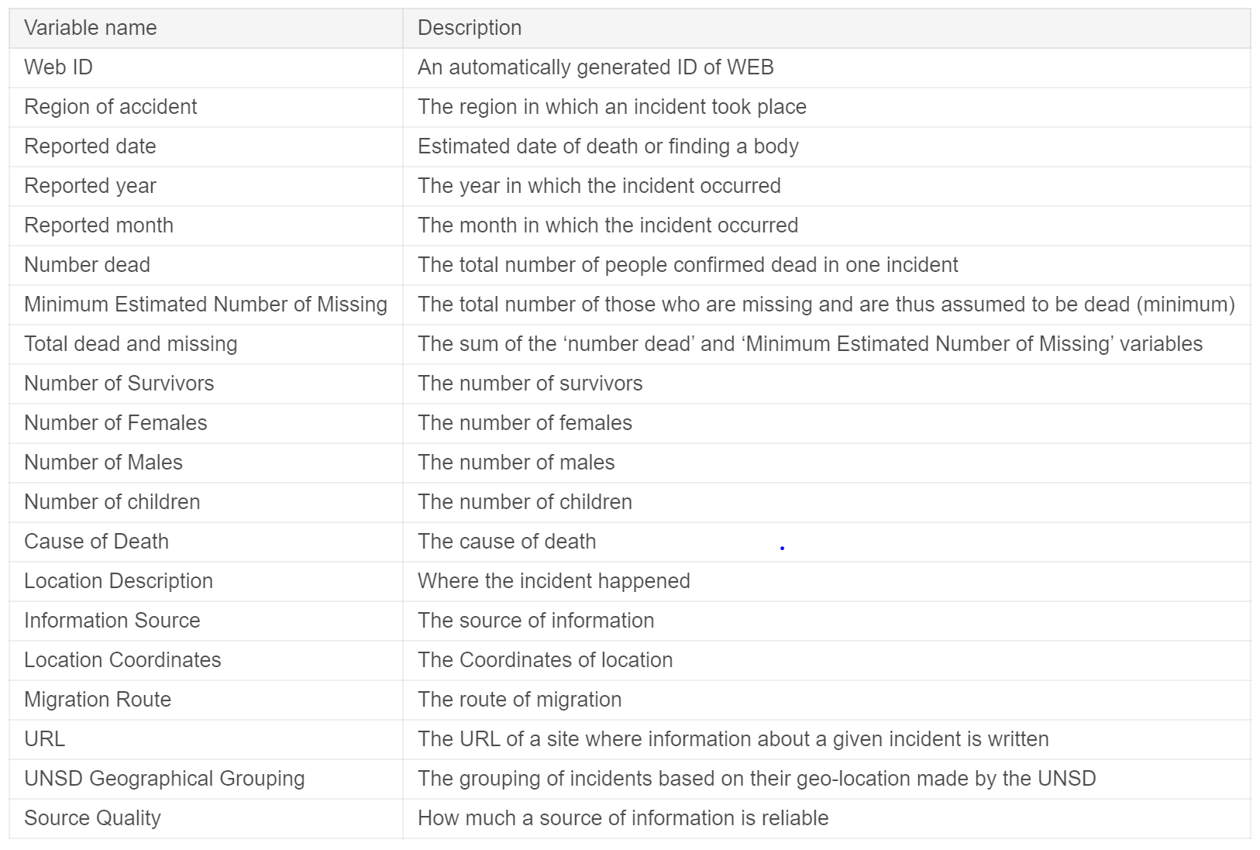
Let's see variables from our dataset

Slide 5

Exploratory Analysis
As we can see on the maps below, the migrants' deaths occur in the countries: from which or to which people migrate, or in the countries in between (which is an obvious conclusion)

Slide 6
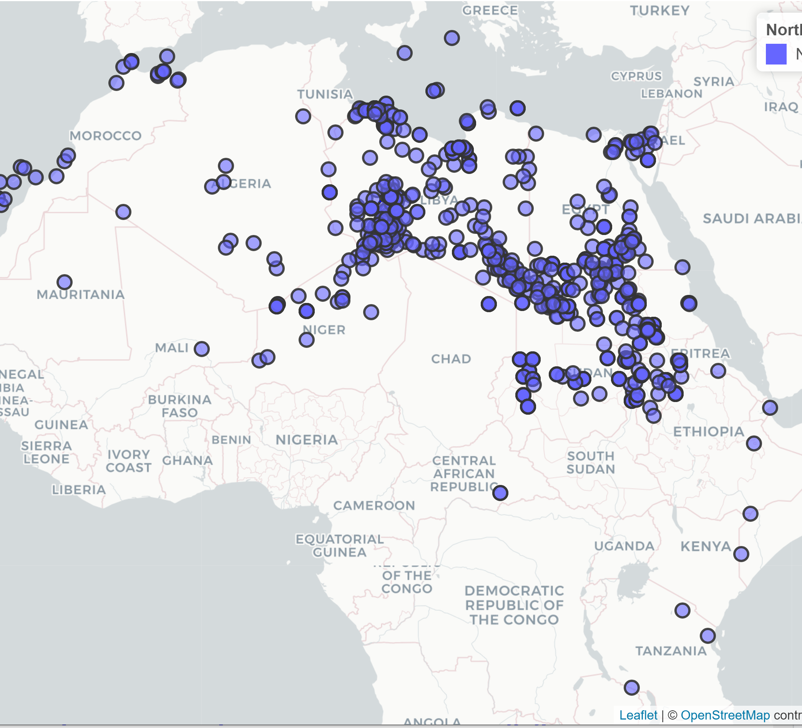
North Africa
Apparanetly, Sudan is a "transit country" (especially from Somalia, Ethiopia and Dem. Rep. Congo), through which masses of people travel, with the hope of reaching Europe. Unfortunately, many of them die, from the harsh weather conditions, on their way there. It can be seen on the map below.

Slide 7

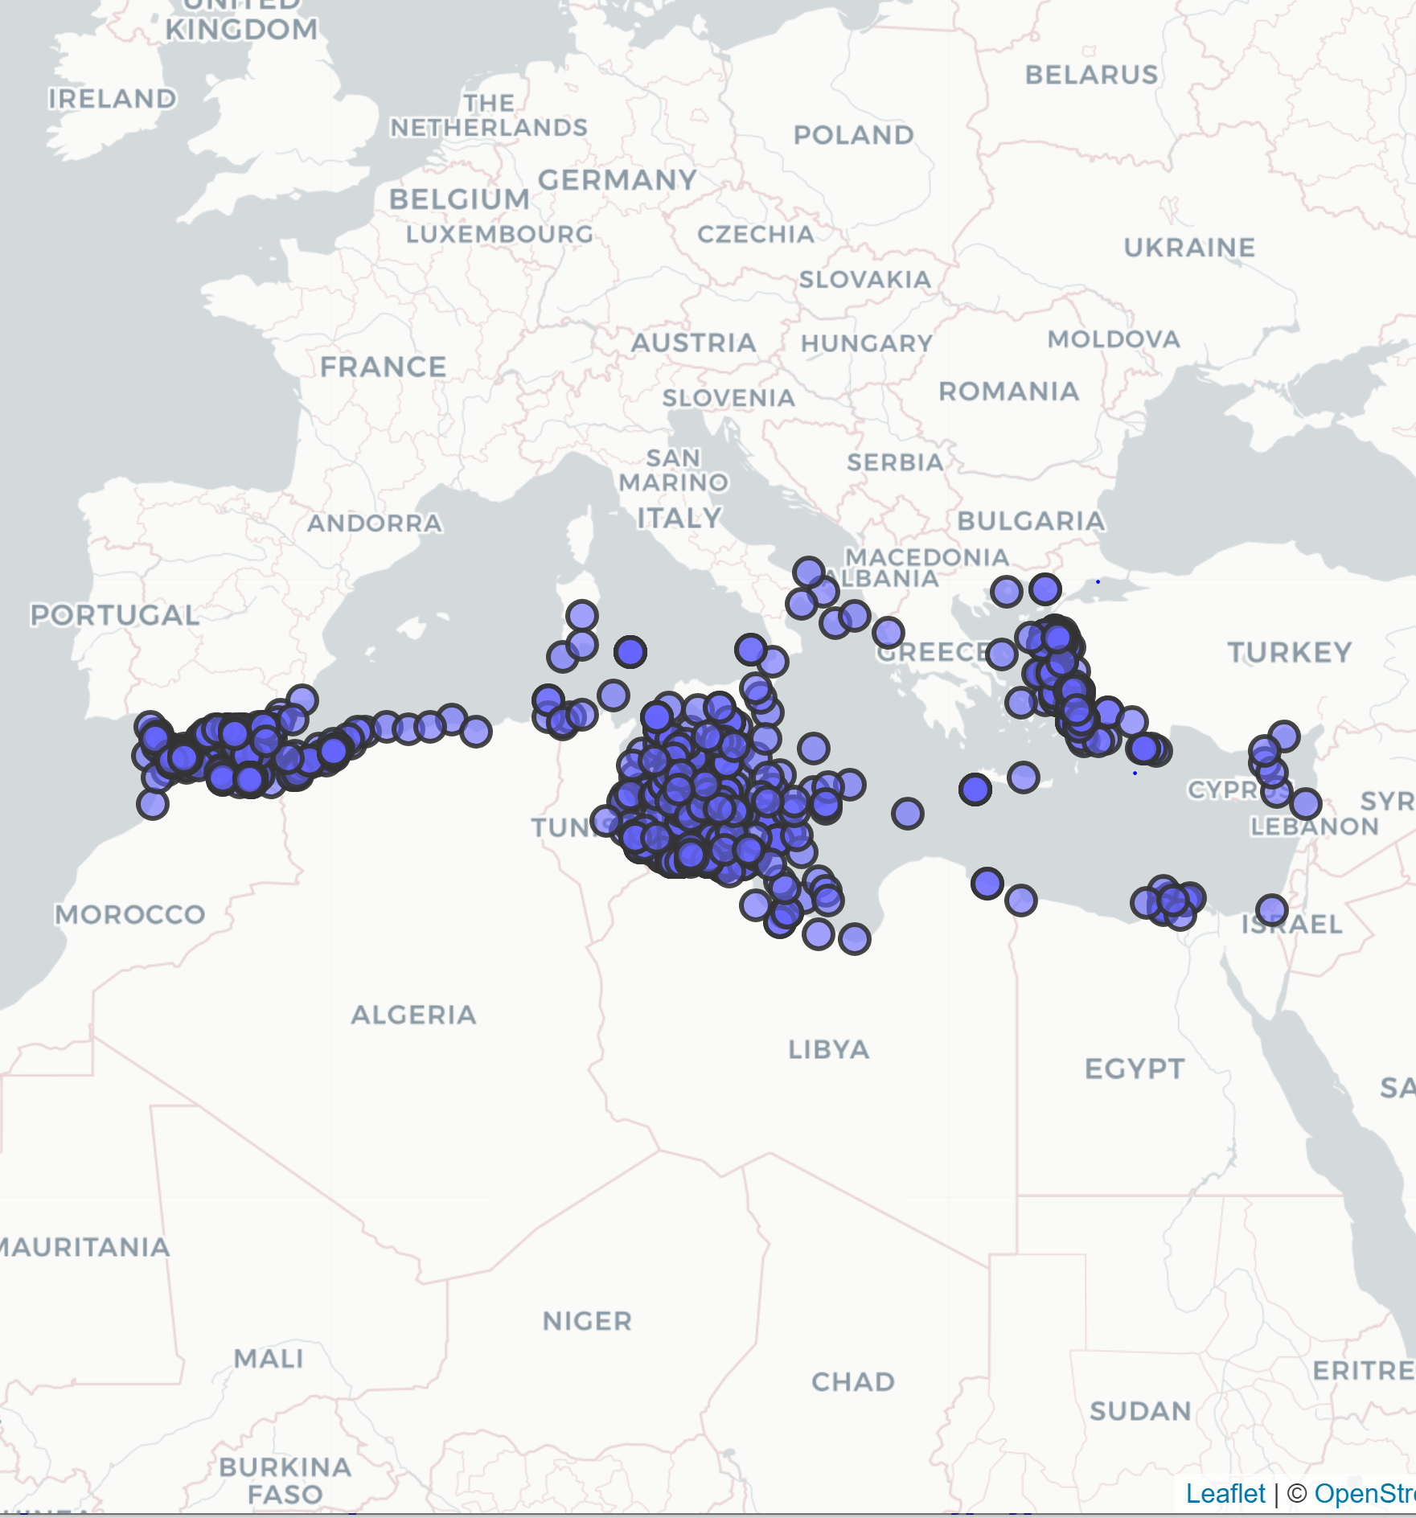
Mediterranean
Those routes have the shortest distance on the see; that's why migrants take them. Other than those, asylum seekers are fleeing from the Middle East, where a few years ago a war broke out (especially in Syria). They migrate through Turkey and then through countries like Hungary, Bulgaria, Austria, Serbia, heading towards the Western Europe. Some of them die falling from the train under La Manche Canal, trying to get to the United Kingdom from the Continental Europe.

Slide 8
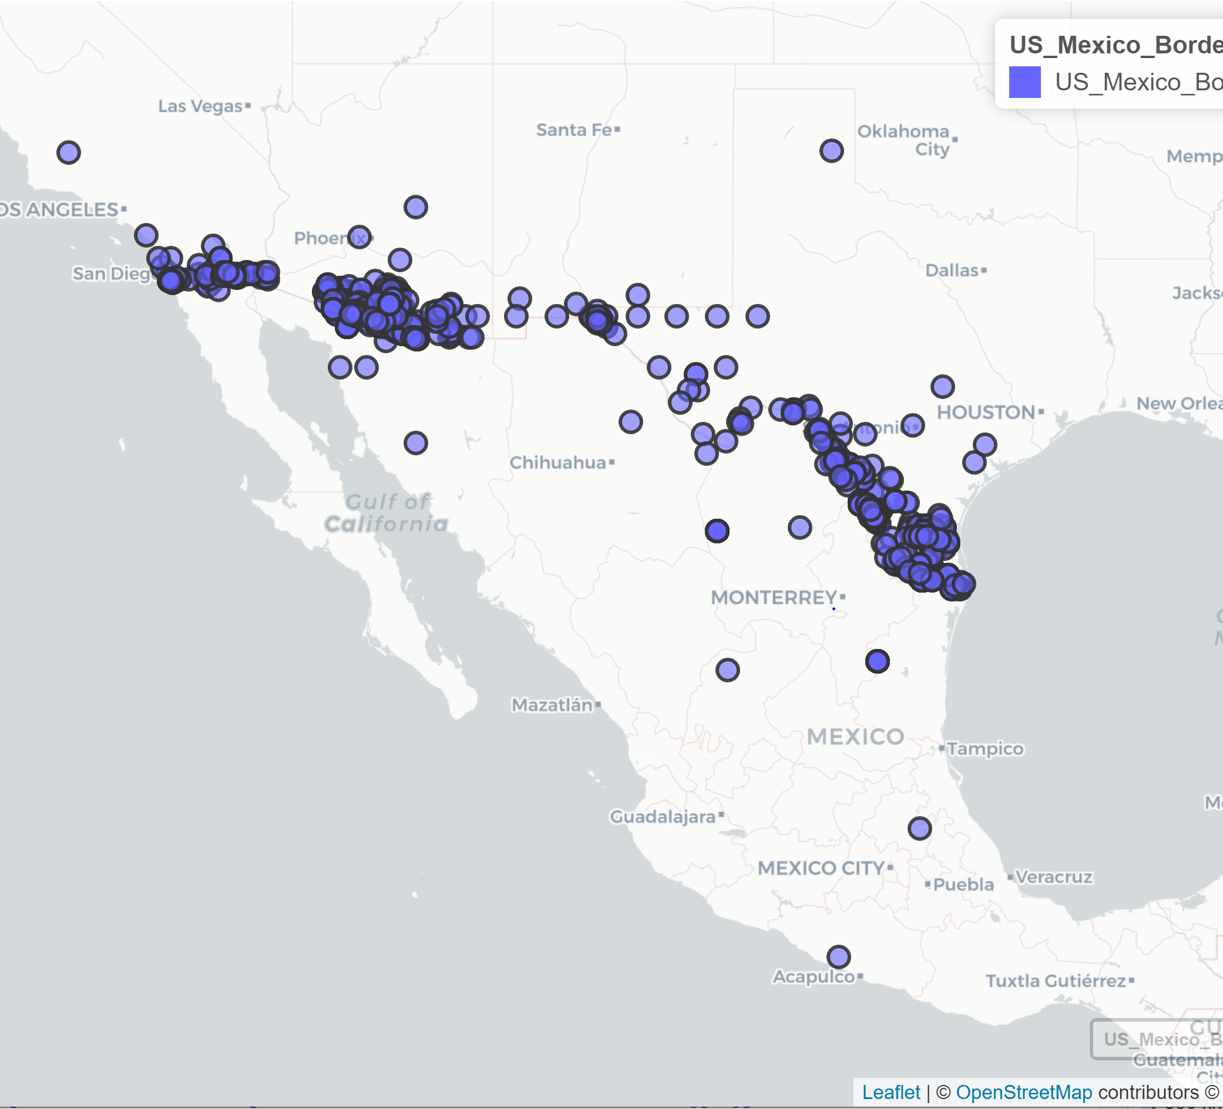
US-Mexico border
Migrants planning to cross the US-Mexico border are more inclined to take a safer ruote, steering away from the desert. Therefore, ironically, on the deserts are less reported deaths, as there are less migrants in those areas. The map below shows it well.

Slide 9
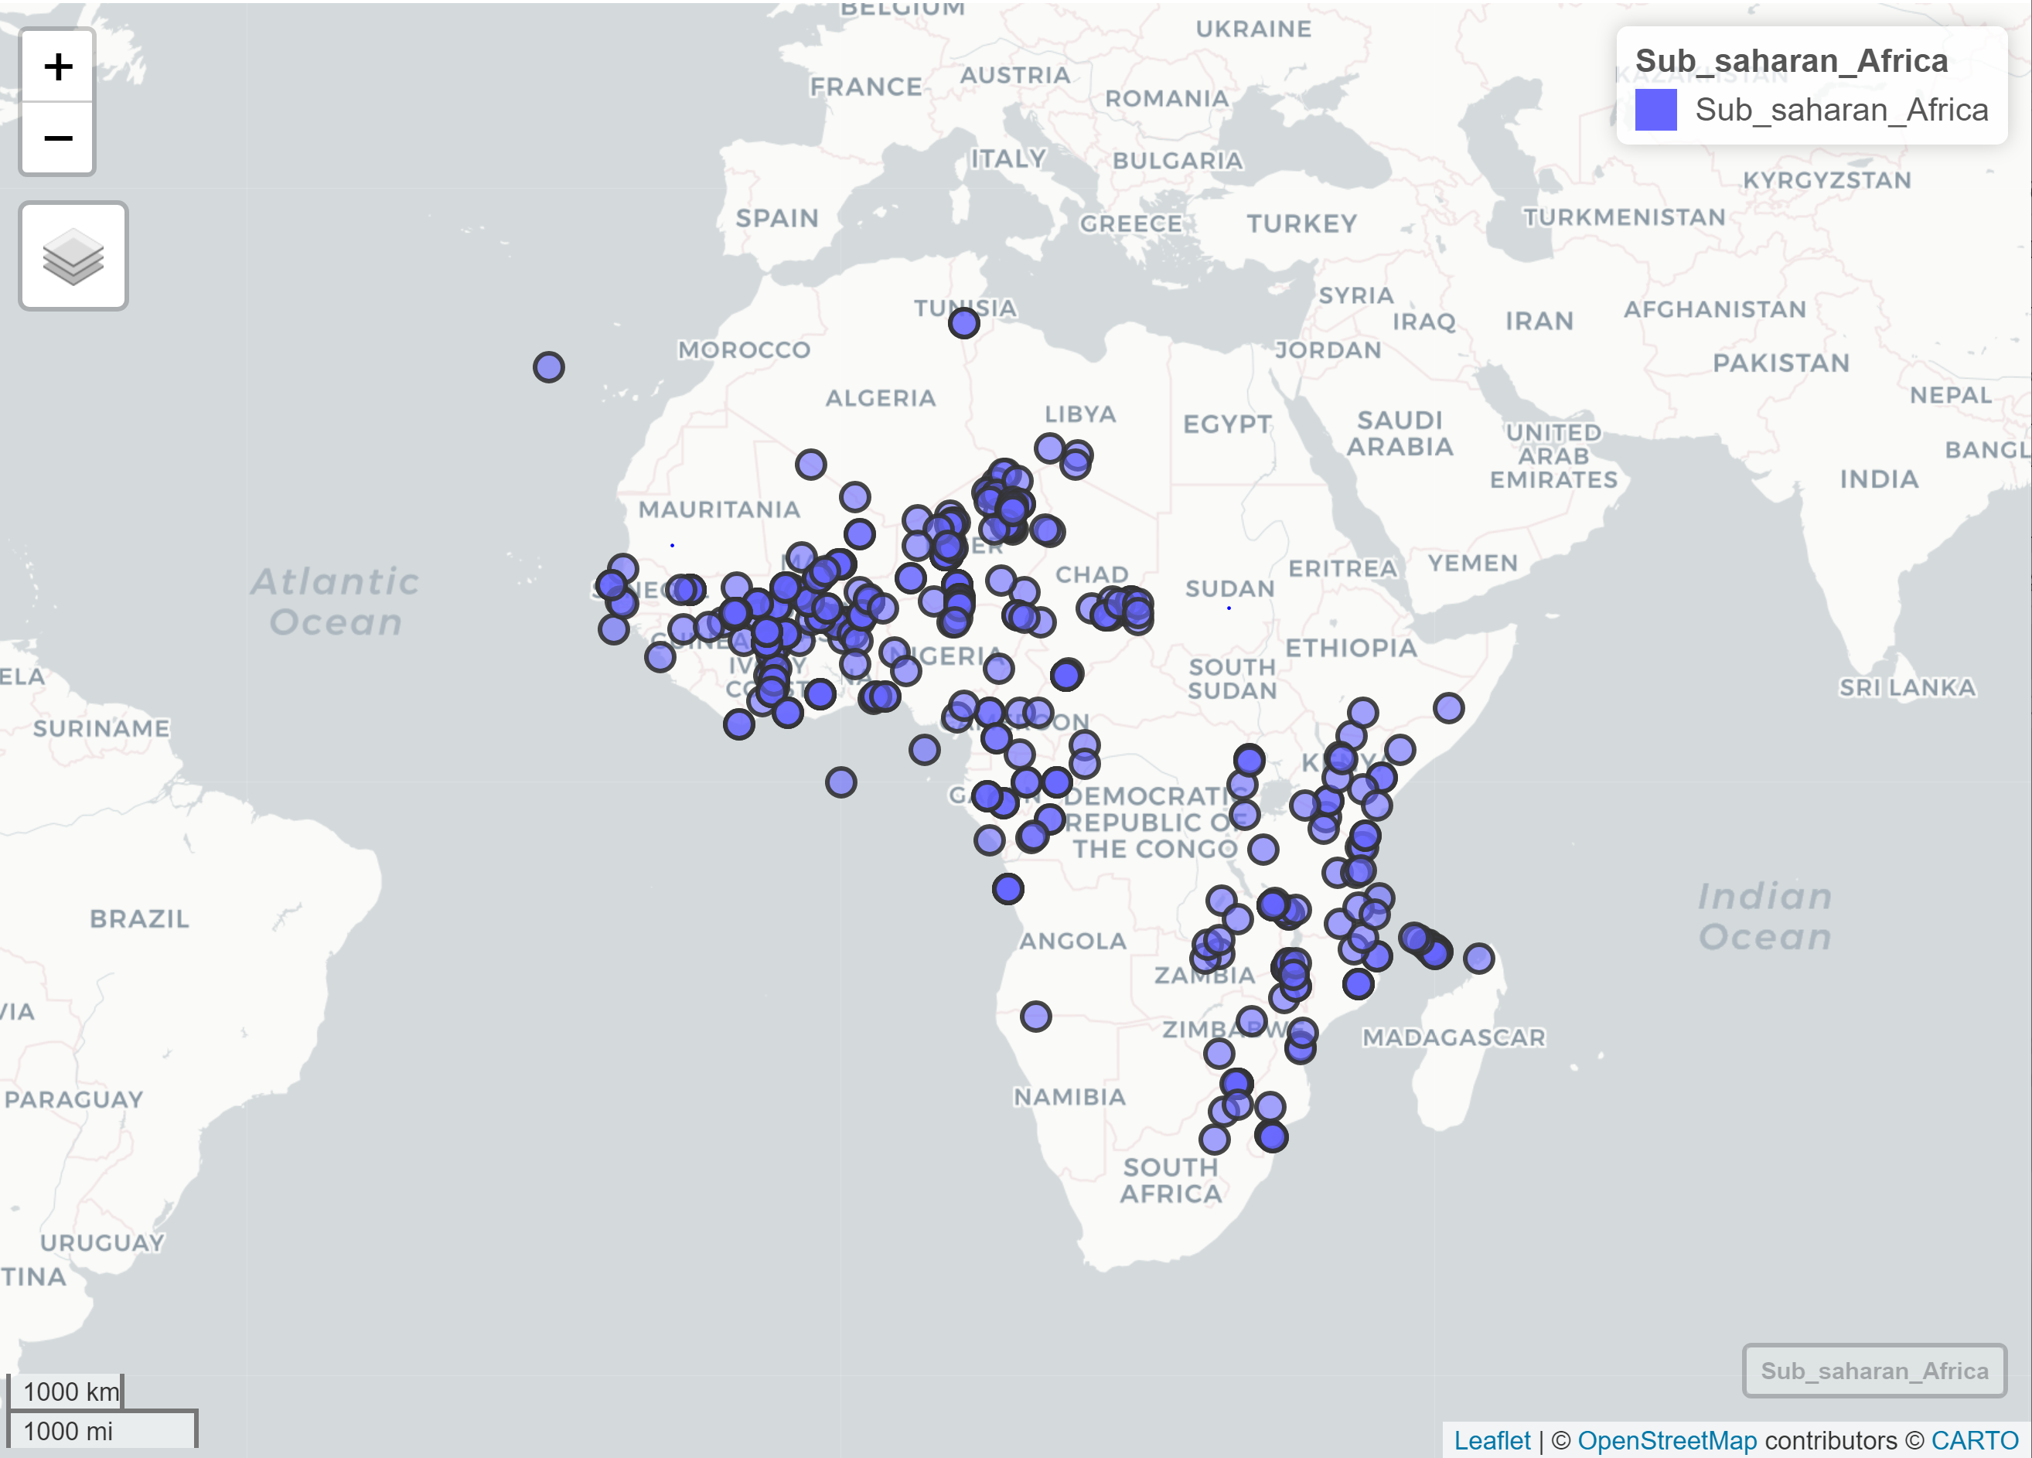
Sub Saharan region
The increased desire of North Africans to migrate from their country permanently is understandable given the increasingly difficult economic conditions in the region.

Slide 10
Visualizing the Causes of Death

Slide 11
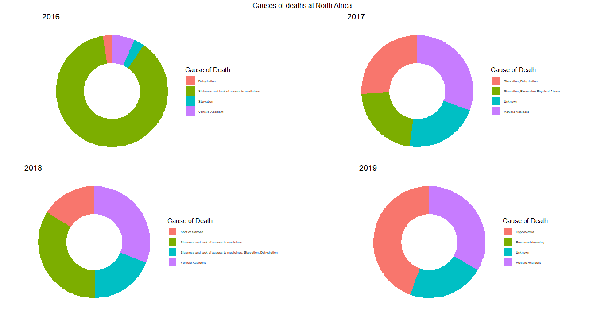
North Africa Region
Most of the people died due to sickness in 2016.
More deaths were due to vehicle accidents and drowning in 2017.
In 2018, more people died due sickness and lack of medicinal access.
In 2019, the major cause of death was Hypothermia.

Slide 12
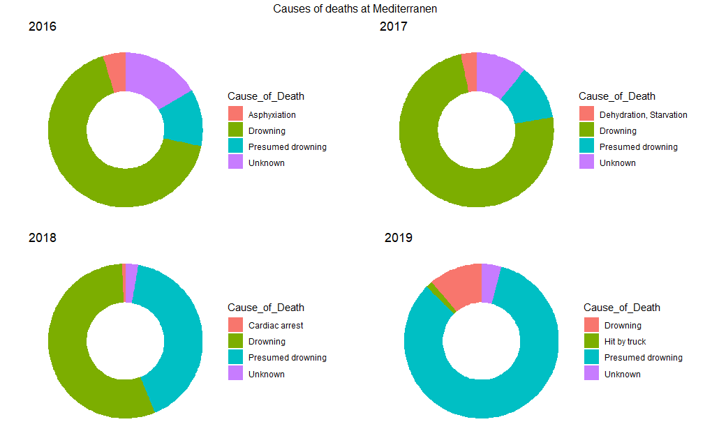
Mediterranean region
The most common cause of death was drowning in Mediterranean region over the years.

Slide 13
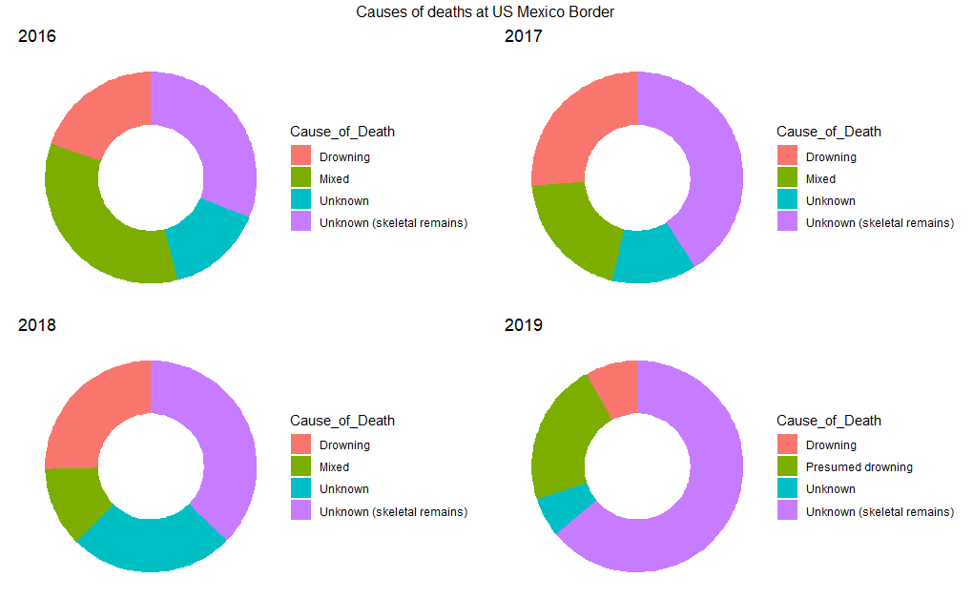
US Mexico Border
The most common cause of death was drowning in US Mexico Border region over the years has been unknown(skeletal remains).

Slide 14
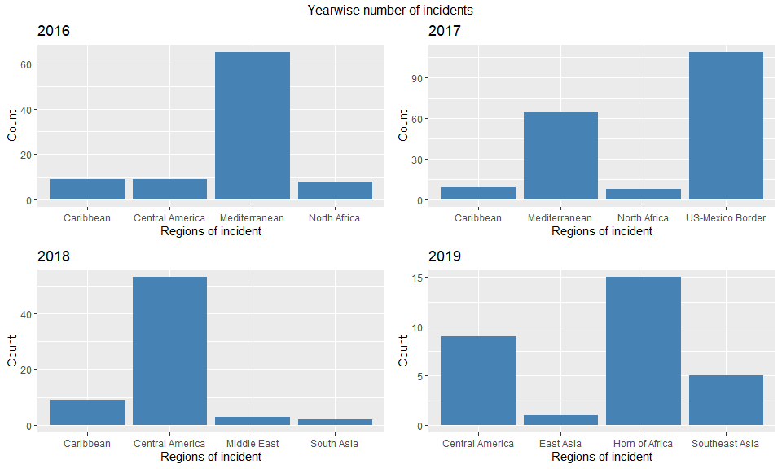
Yearwise Number of Incidents Regionwise

Slide 15
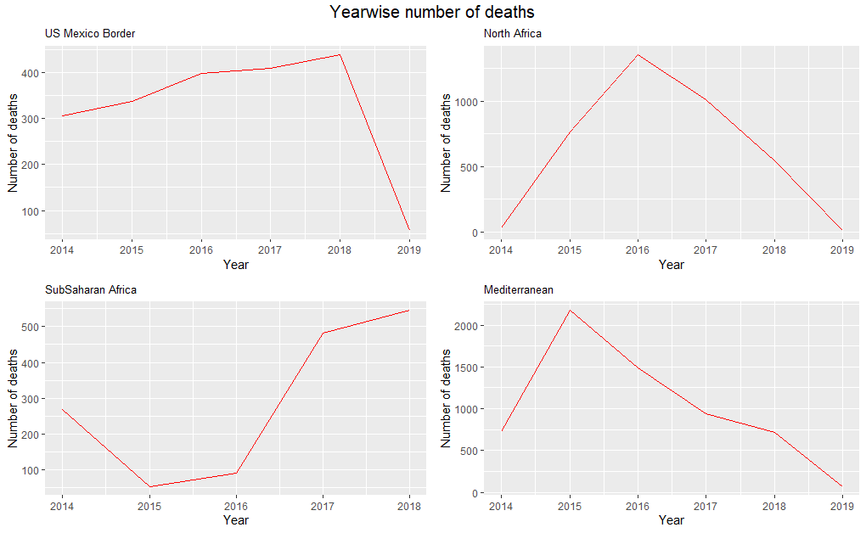
Yearwise No. of Deaths Regionwise
The number of deaths peaked in 2018 in US Mexico Border
The number of deaths peaked in 2016 in North Africa
The number of deaths peaked in 2018 in Sub Saharan Africa
The number of deaths peaked in 2015 in Mediterranean
All this invites speculation as to what events led to these peaks.

Slide 16
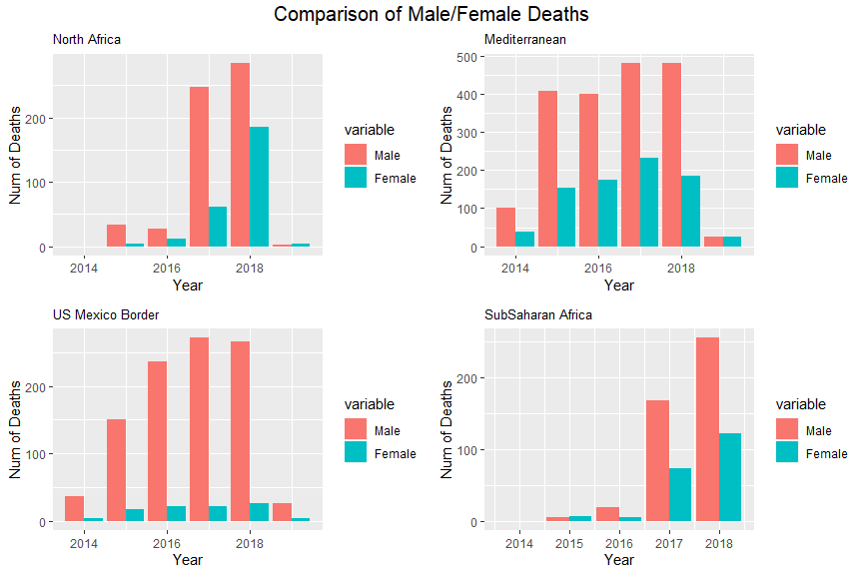
Visualizing Male/Female Deaths Region wise
The male female number of deaths clearly shows the number of males is always higher than the number of females over the years and all over the region.

Slide 17

Statistical Analysis

Slide 18
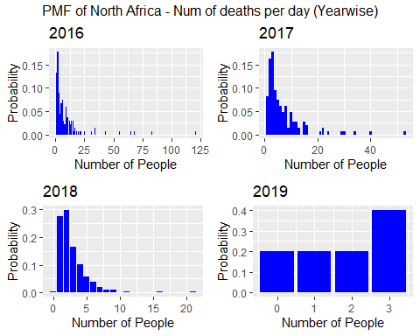
PMF of North Africa – No. of Deaths per day(Yearwise)
Over the years, the number of deaths per day at North Africa have declined.

Slide 19
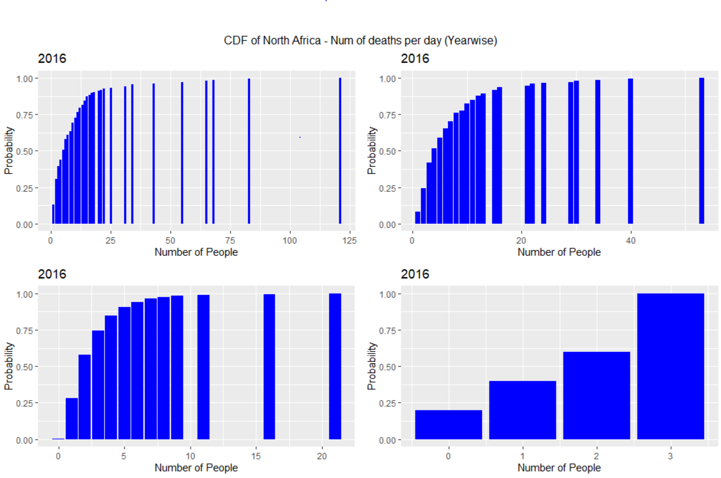
CDF Of North Africa – No. of Deaths per day(Yearwise)
The 4 plots show the Cumulative Distribution Function of the number of deaths of people per day in North Africa each year respectively.

Slide 20
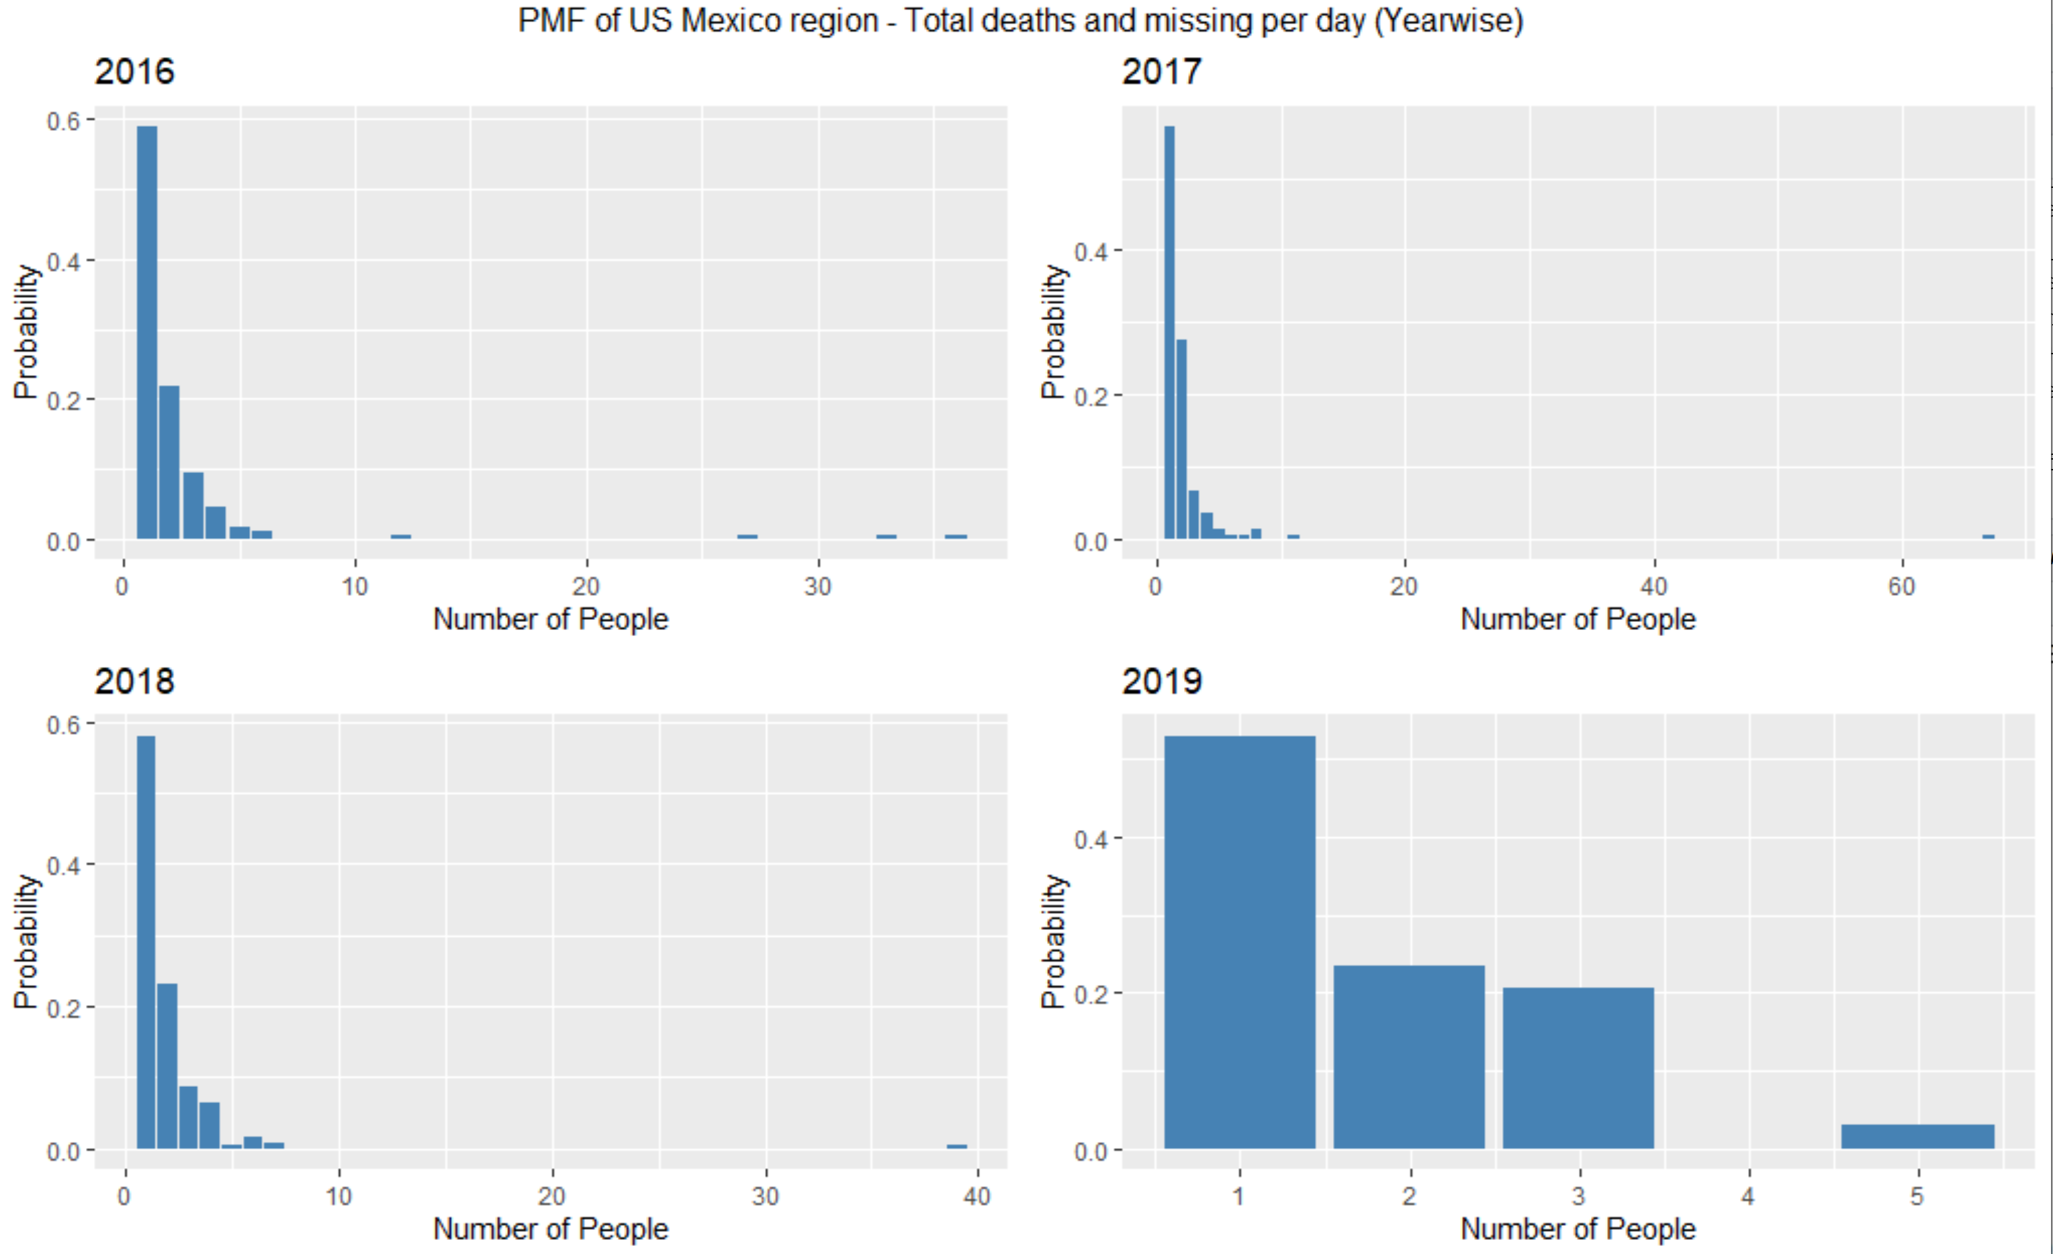
PMF of Mexico – Total No. of Missing and Dead people per day(Yearwise)
The 4 plots show the probability mass function of the total number of dead and missing people per day in Mexico each year respectively.

Slide 21
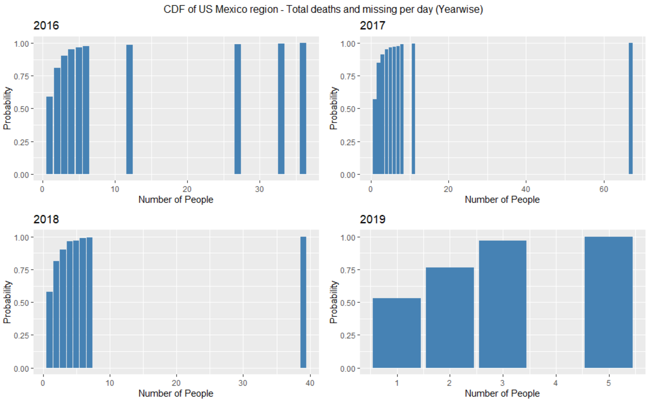
CDF Of Mexico – Total No. of Missing and Dead people per day(Yearwise)
The 4 plo0ts show the Cumulative Distribution Function of the total number of dead and missing people in Mexico each year respectively.

Slide 22
Hypothesis Testing – Number of Survivors and Missing people.

Slide 23
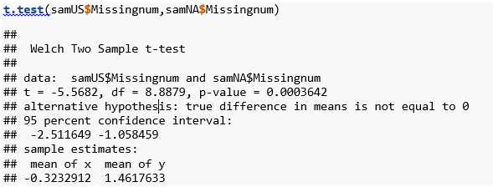
Missing people at US and Africa border
Null Hypothesis : The mean of missing people at US border is equal to mean of missing people at North Africa borders.
Alternate Hypothesis : The mean of missing people at US border is not equal to mean of missing people at North Africa borders.
The number of missing people at US Mexico Border are not same as those of North Africa.

Slide 24
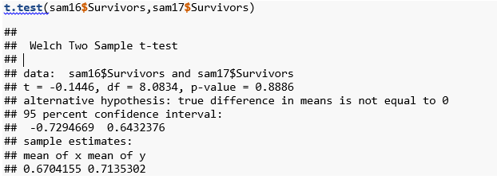
Number of people survived at US Mexico in 2017 and 2018
Null Hypothesis : Mean number of people survived in 2016 is same as 2017
Alternative Hypothesis : Mean number of 2016 survivors are not equal to 2017
The mean number of people who survived in US-Mexico border in 2016 is same as those who survived in 2017.

Slide 25
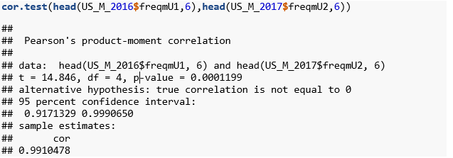
Correlation between 2016 and 2017 deaths at US Mexico border
This suggests that the death count in 2016 is highly correlated to the death count in 2017.

Slide 26
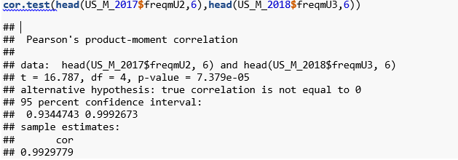
Correlation between 2017 and 2018 deaths at US Mexico border
The number of deaths of 2017 and 2018 are highly correlated.

Slide 27



